Slide 1
Introduction to Unity
A BEGINNER’S TUTORIAL FOR UNITY AND VR

Slide 2
Overview
Unity
  Creating a Project
  Interface
  Navigation
  Customizing Windows
  Asset Store
  Adding Objects to Scene
  Scene Management
  Prefabs
VR Setup
  SteamVR Plugin
  Adding Headset

Slide 3
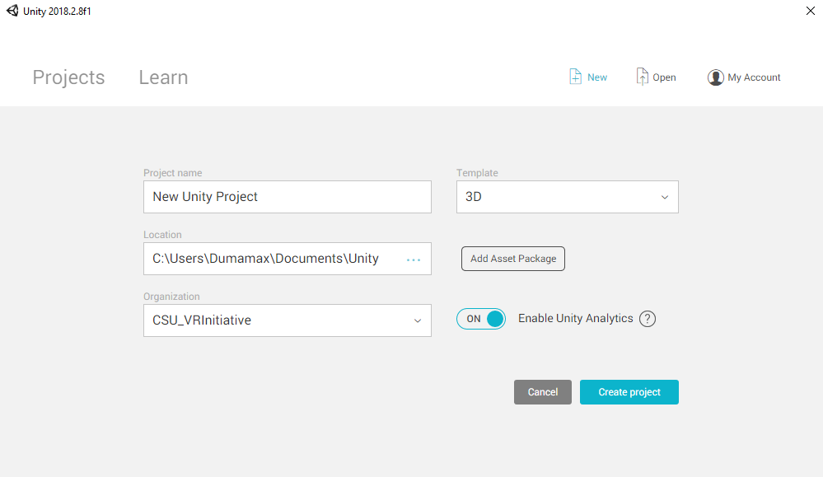
Creating a Project

Slide 4
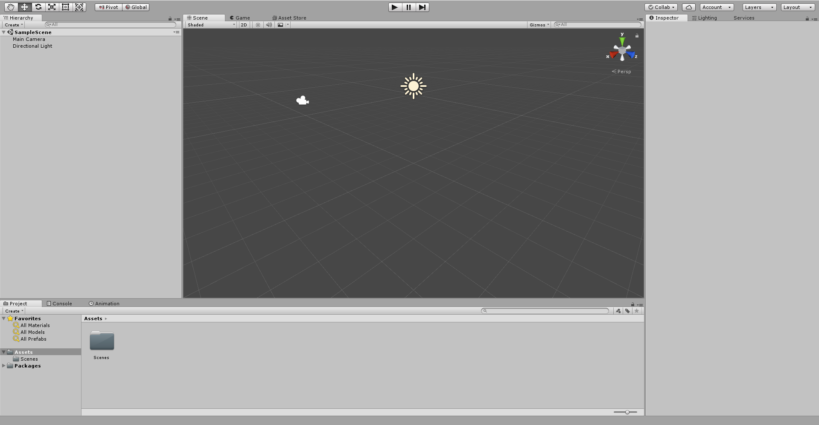

Interface

Slide 5
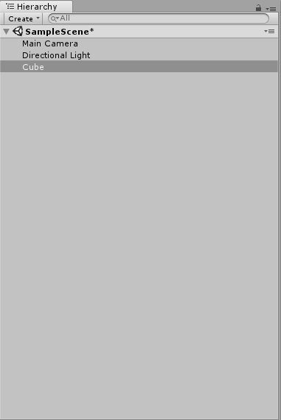
Hierarchy

Slide 6
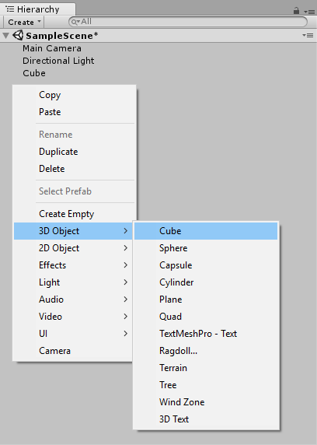
Create a Cube

Slide 7
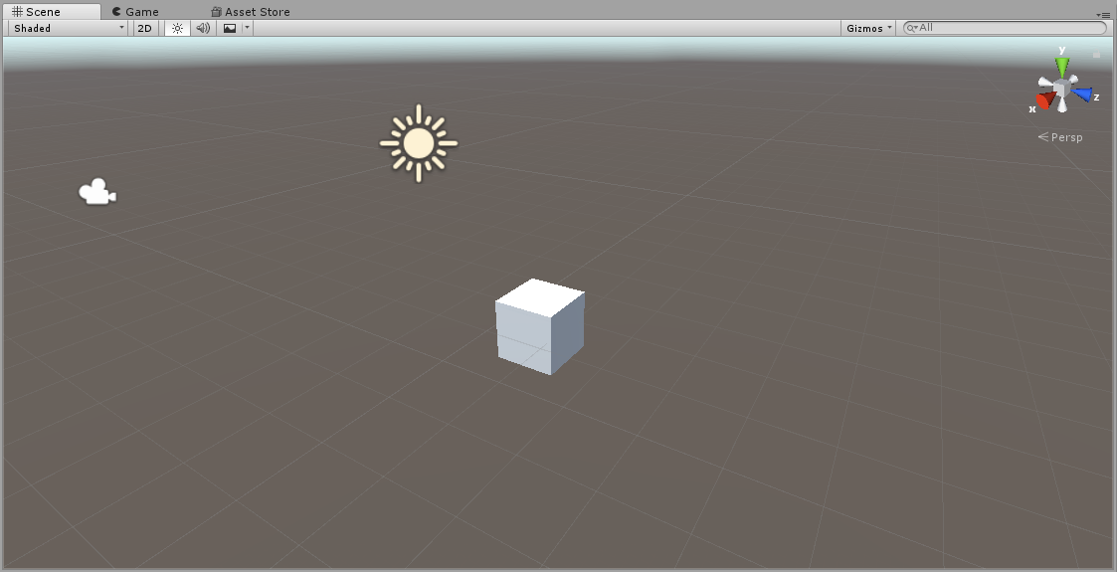
Scene/Game View

Slide 8
Navigating Scene View
Hand Tool: Click and drag to move scene and navigate world
Move Tool: Move objects within the world (X, Y, Z)
Rotate Tool: Rotate objects along the X, Y, or Z axis
Scale Tool: Scale object’s size either along an axis, or overall
Rect Tool: Mainly used for 2D games and UI elements
Universal Tool: Has functionality to move, rotate, and scale

Slide 9
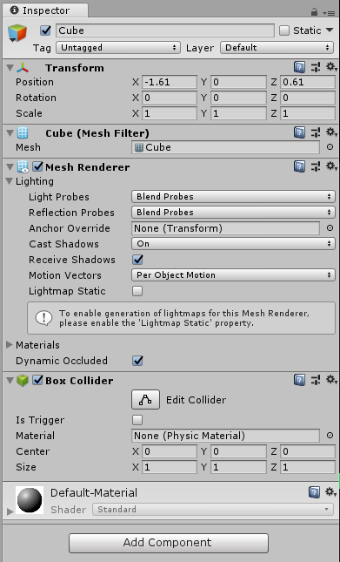
Inspector

Slide 10
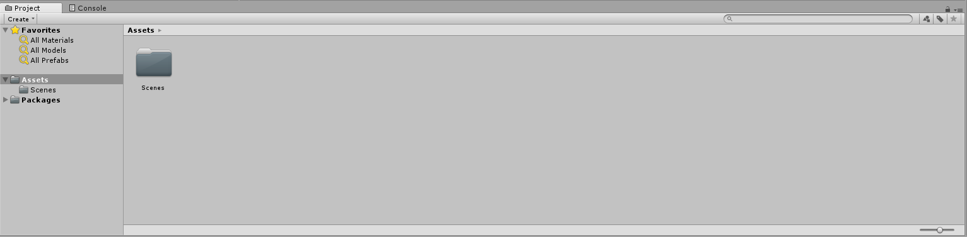
Project Window

Slide 11
Moving Windows to make Custom Layouts
Demo in Unity
  Scale window size
  Change window locations
Notes:
Show how to:
Scale Window size
Drag and drop windows

Slide 12
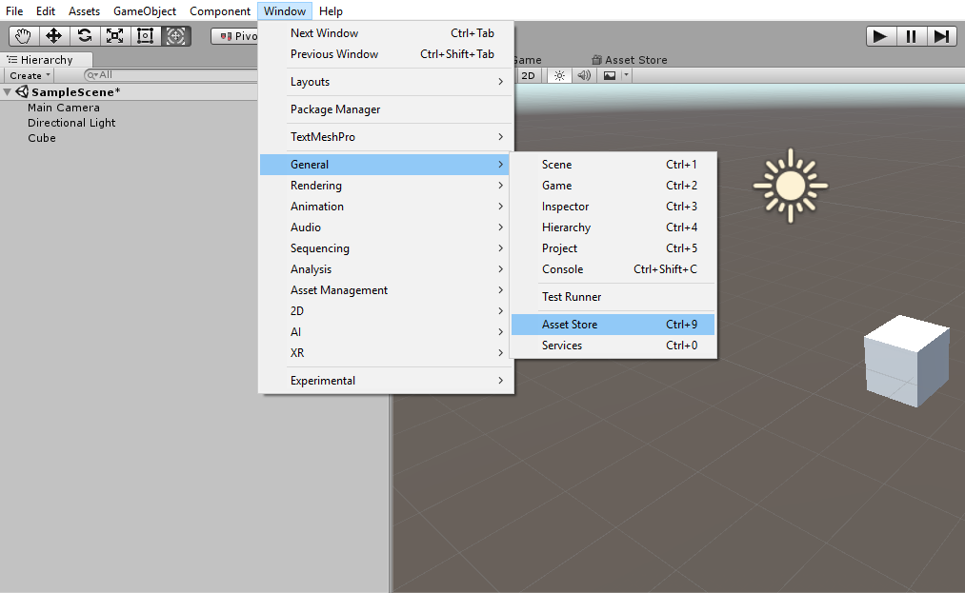
Adding Asset Store as a Window

Slide 13
Importing Assets from Store
Demo in Unity
  Navigate to Props
  Sort by FREE assets
  Find asset pack (Low Poly Survival Essentials)
  Download/Import pack
Notes:
Show how to:
Navigate to Props
Sort by FREE assets
Find asset pack
Download/Import pack

Slide 14
Adding Objects to Scene
In the Project Window, navigate to :
  Assets/BrokenVector/LowPolySurvivalEssentials/Prefabs
Drag and drop Terrain_Plane and set location to (0,0,0)
Add objects for fun ☺
Move camera to see scene in Game View

Slide 15
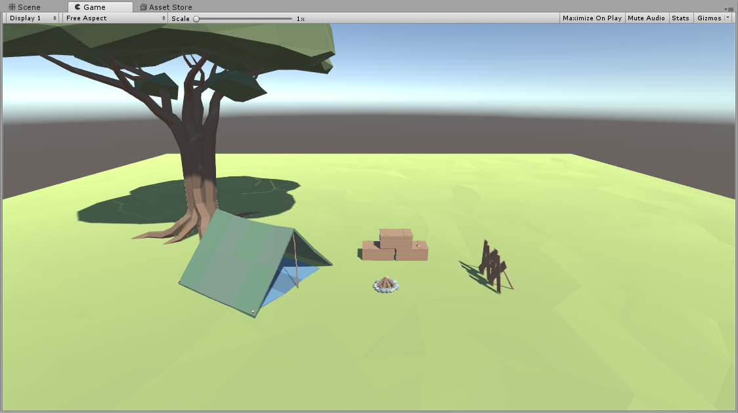

Slide 16
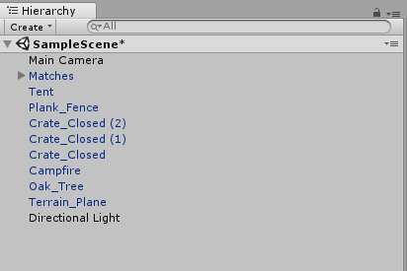
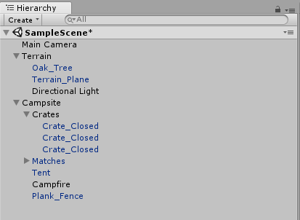
Scene Management
Use Empty Game Objects to create a “Folder Structure”
Before After

Slide 17
Using Prefabs
Prefabs are a valuable resource to use in developing your scene
A prefab is an object or a group of objects that can be saved for easy use and manipulation
Demo in Unity

Slide 18
Questions?
Interface
Navigation
Asset Store
Adding Objects
Scene Management
Anything Else?

Slide 19
Setting up VR in Unity
Go to the Asset Store and search for “SteamVR Plugin”
Download and Import
Click “Accept All” to ensure setting are correct for VR

Slide 20
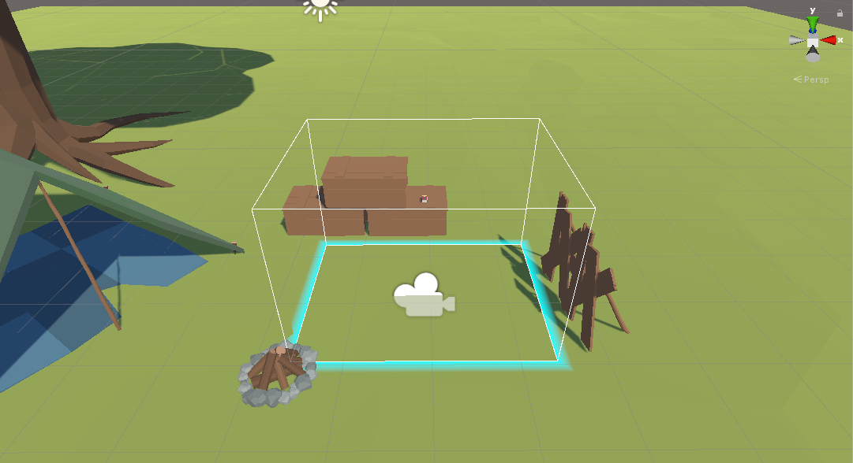
Adding Headset to Scene
Navigate to: Assets/SteamVR/Prefabs
Drag and drop “[CameraRig]” into the project
Delete “Main Camera” from the scene (we only need 1 camera)
Assuming everything works correctly, you are done!

Slide 21
Next steps for VR
We have covered the basics, but there others things
you may want to learn before diving in more:
  Using the Vive in Unity:
    https://circuitstream.com/intro-vr-development-unity-htc-vive/
    Google: “vive unity tutorial” – Second Result
  More about scripting, scene setup, and designing functionality:
    https://unity3d.com/learn/tutorials/s/roll-ball-tutorial
    Google: “unity roll a ball” – First Result

Slide 22
VR Questions?

